Slide 1
CIO.com (Chief Information Officer)
Group Members:
1) Jill Lehmen
2) Tracy Clegg
3) Nattapon Nattigon
4) Clayton Nichols
5) Robert Loggins

Slide 2
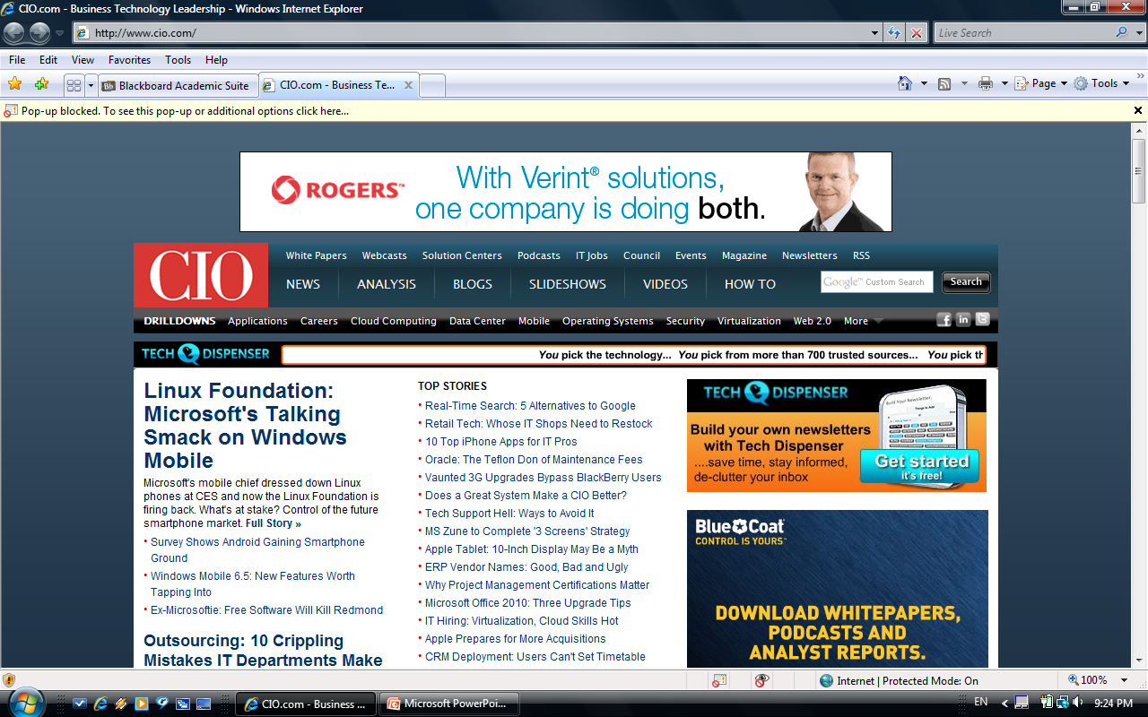
Example of CIO website main page

Slide 3
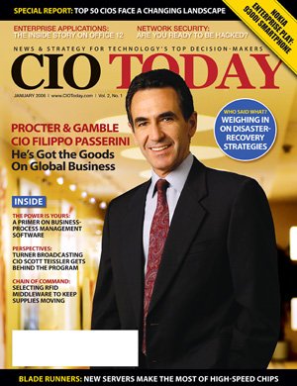
What does CIO focus on?
Focus: To provide IT professionals with information on industry trends and technology.
Major Informational Categories
News
Analysis
Blogs
Slideshows
Videos
Drilldowns
Applications, Careers, Cloud Computing, etc.

Slide 4
What is the Purpose of CIO?
Relay information on:
- IT News Stories
- IT Trends
New Technologies
Tips in doing business related to IT

Slide 5
What’s hot right now?
- Usefulness of smart phones in the IT arena
- Applications for IT professionals
- IT devices becoming more energy efficient or able to use alternative sources of energy
Eg. Solar
- AMD processors

Slide 6
What is important for Managers?
- Technology Section
Adjust to new business trends.
- Business/Management Section
Gain tips in managing business related IT functions.
- IT Drilldown Section
These sections will enhance the careers of business technology leaders.

Slide 7
What Things Should Managers Look to Get From CIO?
Look for ways to increase company marketability.
- Increase knowledge of the technology industry.
- Best Practices from other companies
- New technologies and innovations
- Hardware and Software information

Slide 8
How Can Managers Benefit?
- Stay informed on current trends and technologies.
- Remain on the cutting edge of future technologies.
- Industry Benchmarking.
- Improve company’s bottom line.
- New opportunities for product and market development.

Slide 9
Questions?

